Slide 1

Basics of Java Programming
Designed by James Gosling
Developed by Sun Microsystems
Object Oriented Programming Language
Class based
“Write once run anywhere”
Client-server web Applications

Slide 2
Content
Data types
Operators types
Control Statements
Classes and Objects
Methods
Constructors

Slide 3
Content
Inheritance
Access Specifiers
Interfaces
Packages
Annotation
Exceptions

Slide 4
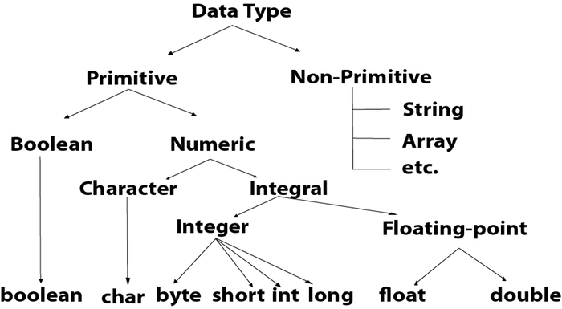
Data types

Slide 5
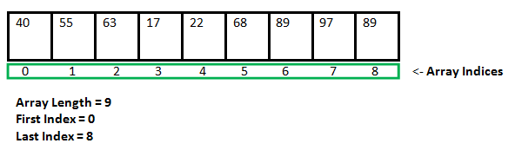
Arrays
Array:
  Collection of similar kind of elements
  Syntax:
  Declaration:
      var_name = new type[size];
type var_name[];
OR
type[] var_name;

Slide 6
Operators
Arithmetic Operators: + , - , * , / , %
Unary Arithmetic Operators: ++ , -- , !
Relational Operators: == , != , < , > , <= , >=
Logical Operator: && , ||
Bitwise Operator: & , | , ^ , ~
Assignment Operator: += , -= , *= ,/= , %= , ^=
Conditional Operator: ? :
Shift Operator: << , >> , >>>

Slide 7
Control Statements
Decision Making Statements:
    if, if-else,else-if ladder,nested if,switch
Loop control statements:
    while,for,do-while
Branching statements:
        Break
        Continue

Slide 8
Classes and Objects
Class is user defined data type
Blueprint
Objects can be created
Class is a template
Example: Table,Human being
Object is an instance of a class

Slide 9
Sample Java Program
public class MyClass{
  public static void main(String args[]){
          System.out.println(“Hello World!”);
      }
}

Slide 10
Methods
Performs a specific task
Reusable
Time saving

Slide 11
Method definition
Syntax:
returntype method_name(arguments){
  //body
}
Example:
int methodName(int a, int b) {
// body
}

Slide 12
Constructors
Initializes objects of the class
Same name as the of class name
Example: Table -> height, width, color
  class Myclass{
        Myclass(){
          .....
          }
          ....
          }

Slide 13
Inheritance
Object acquires all properties & behaviour of parent class
Example:- Employee <-- Programmer
extends keyword:
The extends keyword extends a class (indicates that a class is inherited from another class)

Slide 14
super keyword
The super keyword refers to superclass (parent) objects.
It is used to call superclass methods, and to access the superclass constructor.
The most common use of the super keyword is to eliminate the confusion between superclasses and subclasses that have methods with the same name.

Slide 15
Example
class Animal { // Superclass (parent)
public void animalSound() {
System.out.println("The animal makes a sound");
}
}
class Dog extends Animal { // Subclass (child)
public void animalSound() {
super.animalSound(); // Call the superclass method
System.out.println("The dog says: bow wow");
}
}
public class MyMainClass {
public static void main(String args[]) {
Animal myDog = new Dog(); // Create a Dog object
myDog.animalSound(); // Call the method on the Dog object
}
}

Slide 16
this keyword
The this keyword refers to the current object in a method or constructor.
The most common use of the this keyword is to eliminate the confusion between class attributes and parameters with the same name
Example:
public class MyClass {
int x;
public MyClass(int x) {
this.x = x;
}
public static void main(String[] args) {
MyClass myObj = new MyClass(5);
System.out.println("Value of x = " + myObj.x);
}
}

Slide 17
Access Specifiers
Private
Protected
Public

Slide 18
Private Access Specifier
The private keyword is an access modifier used for attributes, methods
and constructors, making them only accessible within the declared class.
Example:
public class Person {
private String name = "John";
private int age = 24;
public static void main(String[] args) {
Person myObj = new Person();
System.out.println("Name: " + myObj.name);
System.out.println("Age: " + myObj.age);
}
}

Slide 19
Protected Access Specifier
The protected keyword is an access modifier used for attributes, methods
and constructors, making them accessible in the same package and subclasses.
public class Person {
protected String name = "John";
protected int age = 24;
}
class Myclass extends Person{
public static void main(String[] args) {
Person myObj = new Person();
System.out.println("Name: " + myObj.name);
System.out.println("Age: " + myObj.age);
}
}

Slide 20
Public Access Specifier
The public keyword is an access modifier used for classes, attributes, methods and constructors, making them accessible by any other class.
Example:
public class Person {
public String name = "John";
public int age = 24;
}
class Myclass{
public static void main(String[] args) {
Person myObj = new Person();
System.out.println("Name: " + myObj.name);
System.out.println("Age: " + myObj.age);
}
. }

Slide 21
dot operator(.) and new operator
The (.) operator is also known as member operator it is used to access the member of a package or a class.
The 'new' operator in java is responsible for the creation of new object or we can say instance of a class.

Slide 22
Usage of dot operator & new operator
public class Sample {
void display() {
double d = 20.3;
int i = (int)d;
System.out.println(i);
}
    public static void main(String args[]) {
Sample s = new Sample();
s.display();
}
}

Slide 23
Interface
An interface is an abstract "class" that is used to group
related methods with "empty" bodies
Has abstract methods, static constants
Has no body
implements keyword
To access the interface methods, the interface must be "implemented" (kinda like inherited) by another class with the implements keyword (instead of extends)

Slide 24
Interface Example
interface Pet{
public void test();
}
class Dog implements Pet{
public void test(){
System.out.println("Interface Method Implemented");
}
public static void main(String args[]){
Pet p = new Dog();
p.test();
}
}

Slide 25
import keyword
The import keyword is used to import a package, class or interface.
import java.util.Scanner;
class MyClass {
public static void main(String[] args) {
Scanner myObj = new Scanner(System.in);
System.out.println("Enter username");
String userName = myObj.nextLine();
System.out.println("Username is: " + userName);
}
}

Slide 26
Packages
The package keyword creates a package.
Group of similar types of classes,interface & subpackages
Few packages:- lang,java,io,util,awt etc
Example:
package mypack;
class MyPackageClass {
public static void main(String[] args) {
System.out.println("This is my package!");
}
}

Slide 27
@Override
When a method is marked with the @Override annotation, the compiler will perform a check to ensure that the method does indeed override or implement a method in super class or super interface.
Example:
class Foo {
public void doSomething(String thing, int times) {
//body
}
}
class Bar extends Foo {
@Override
public void doSomething(String thing, int times) {
// do something
}
}

Slide 28
Exception
An exception is an object that wraps an error event that occurred within a method.
Contains:
Information about the error including its type
The state of the program when the error occurred
Optionally, other custom information
Handling Exceptions:
try
catch
finally

Slide 29
try-catch-finally
try {
// Code bock
}
catch (ExceptionType1 e1) {
// Handle ExceptionType1 exceptions
}
catch (ExceptionType2 e2) {
// Handle ExceptionType2 exceptions
}
// ...
finally {
// Code always executed after the
// try and any catch block
}

Slide 30
Example:
public class MyClass {
public static void main(String[] args) {
try {
int[] myNumbers = {1, 2, 3};
System.out.println(myNumbers[10]);
} catch (Exception e) {
System.out.println("Something went wrong.");
}
}
}

Slide 31
API’s
An application program interface (API) is a set of routines, protocols, and tools for building software applications.
How components should interact with humans
used for programming graphical user interface (GUI) components

